Slide 1
BS9001: Research experience
Meta-Analysis of Breast Cancer Using Data Science Techniques
by Justin Chia

Slide 2
Meta-analysis
What? - A statistical procedure for combining data from multiple studies
Why? – It synthesizes data across studies. It takes variations in results from different studies into consideration such as confounding factors and batch effects.
How? – Identifying a problem, doing a literature search, deciding on selection and inclusion criteria, data extraction, doing the meta-analysis
Focus for this project is on breast cancer

Slide 3
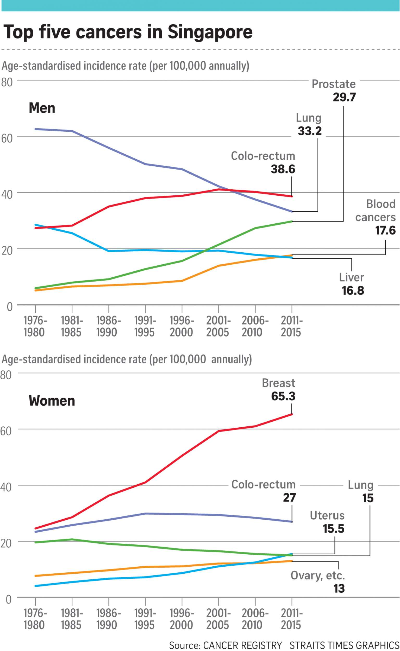
Breast cancer
Breast cancer is both the most common cancer and the most common cause of death among women
To understand its workings, it is important to understand the genetic profiling of genes that are significantly expressed in breast cancer.
The type of breast cancer analysed in this study is Invasive Ductal Carcinoma

Slide 4
Research process
Selection of scope and corpus
Data Extraction
Data Compression
Bootstrap
Data Visualization

